Slide 1
RUNGTA COLLEGE OF DENTAL SCIENCES & RESEARCH
TITLE OF THE TOPIC : FUNDAMENTALS OF TOOTH PREPARATION
DEPARTMENT OF CONSERVATIVE DENTISTRY AND ENDODONTICS

Slide 2
Specific learning Objectives
At the end of this presentation the learner is expected to know ;
Core areas* | Domain ** | Category #
PRINCIPLES OF TOOTH PREPARATION, GV BLACK CLASSIFICATION | COGNITIVE | MUST KNOW
OBJECTIVES OF TOOTH PREPARATION , TECHNIQUES OF TOOTH PREPARATION | PSYCHOMOTOR | NICE TO KNOW
TERMOLOGIES OF TOOTH PREPARATION | AFFECTIVE | DESIRE TO KNOW
*Subtopic of importance
** Cognitive, Psychomotor or Affective
# Must know , Nice to know & Desire to know
( Table to be prepared as per the above format )

Slide 3
Table of Content
TOOTH PREPARATION
NEED FOR RESTORATION
OBJECTIVES OF TOOTH PREPARATION
EXTENT OF CARRIES
INFECTED DENTIN
AFFECTED DENTIN
TERMONOLOGIES OF TOOTH PREPARATION
TOOTH PREPARATION ANGLE
GV BLACK CLASSIFICATION
STAGES AND STEPS IN TOOTH PREPARATION
TECHNIQUES
OBJECTIVES
REFERENCES

Slide 4
Fundamentals Of Tooth Preparation

Slide 5
Tooth Preparation
It is defined as the mechanical alteration of a defective , injured , or diseased tooth to best receive a restorative material that will reestablish a healthy state of tooth , including esthetic corrections where indicated , along with normal form & function.

Slide 6
Need for restoration
To repair tooth after carious lesion.
Replacement or repair of an existing restoration.
Required in # teeth.
To restore form & function [congenital malformation].
Esthetics.
Required for other restorative needs[RPD,FPD]

Slide 7
Objectives Of Tooth Preparation
Remove all defects & provide necessary protection to the pulp.
Extend restoration as conservatively as possible.
Tooth preparation should be such that tooth as well as restoration should not # under forces of mastication.
Allow for esthetic & functional placement of a restorative material.

Slide 8
Extent Of Caries
Incipient / Reversible Caries:
First evidence seen on smooth surface.
Appears as opaque whith lesion on air dried &white seem to disappear.
This lesion of demineralised enamel has not extended to DEJ & surface enamel is fairly hard & intact.
This lesion can be remineralised with immediate corrective measures ,so termed as REVERSIBLE.

Slide 9
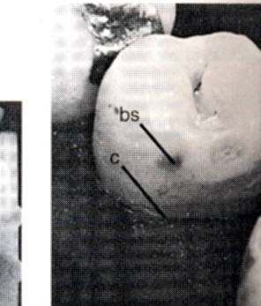
Incipient / Reversible Caries
Remineralised lesion appears as opaque white or brown to black & has a hard surface.

Slide 10
Cavitated / Nonreversible Caries
Enamel surface not intact.
Lesion has spread to dentin.
Remineralisation not possible.
Restoration indicated.

Slide 11
Rate:Acute [Rampent] Caries
Lesion rapidly spreads.
It is soft,light colored & infectious.

Slide 12
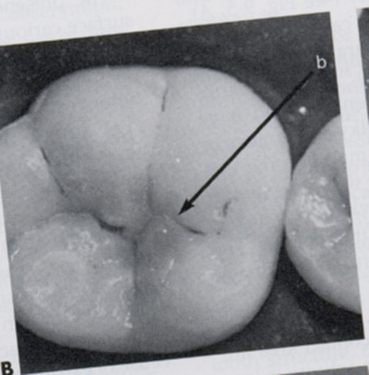
Rate: Chronic[slow/arrested] Caries
Slow in progress.
Demineralised tooth structure gets remineralised.
So it is Arrested.
It is hard & brown to black.

Slide 13
Carious Dentin
Carious dentin consists of two distinct layers :an outer layer-Infected dentin
:an inner layer-Affected dentin

Slide 14
Infected Dentin
Texture is soft.
Bacteria are present.Collagen irreversibly denatured.
Remineralisation not possible.Removal of infected dentin indicated to avoide spread of infection.

Slide 15
Affected Dentin
Texture is hard.
It is an area of decalcification before the penetration of micro –organisms.Not invaded by micro-organisms.
Collagen reversibly denatured & remineralisation possible.Can be left behind with out removal.

Slide 16
Terminologies Of Tooth Preparation
Internal Wall : prepared cavity surface which does not extend to external tooth surface.
Axial Wall :an internal wall parallel to long axis of tooth.
Pulpal Wall : an internal wall perpendicular to long axis of tooth & occlusal of pulp.

Slide 17
Terminologies Of Tooth Preparation
External Wall :prepared cavity surface that extends to the external tooth surface & takes the name of the tooth surface that the wall is towards.External walls are Distal , Mesial , Lingual ,Facial & Gingival.
Enamel Wall :is portion of external wall that consists of enamel.

Slide 18
Terminologies Of Tooth Preparation
Dentinal Wall : is a portion of external wall that consists of dentin.
Floor / Seat :prepared cavity wall that is relatively flat & perpendicular to forces of mastication that are directed along the long axis of the tooth.
Pulpal Floor & Gingival Seat .

Slide 19
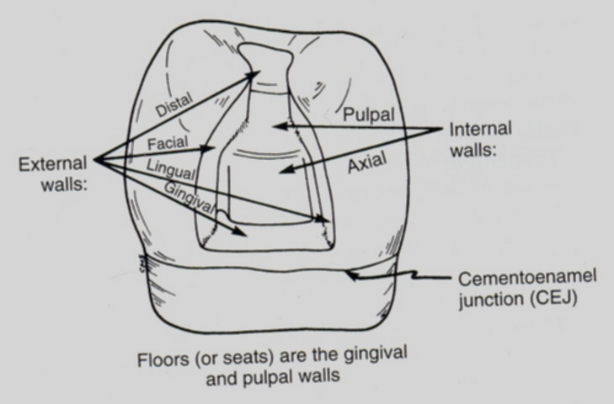

Slide 20
Tooth Preparation Angles
Line Angle :is the junction of two planal surfaces of different orientations along a line.2 types are:Internal Line Angle
:External Line Angle
Internal Line Angle :is the one whose apex points into the tooth e.g faciopulpal line angle.
External Line Angle :is the one whose apex points away from the tooth e.g axiopulpal line angle.

Slide 21
Tooth Preparation Angles
Point Angle :is the junction of three planal surfaces of different orientations . E.g mesiofaciopulpal.
Cavosurface Angle :is the angle of the tooth surface formed by the junction of prepared cavity wall & external tooth surface.

Slide 22
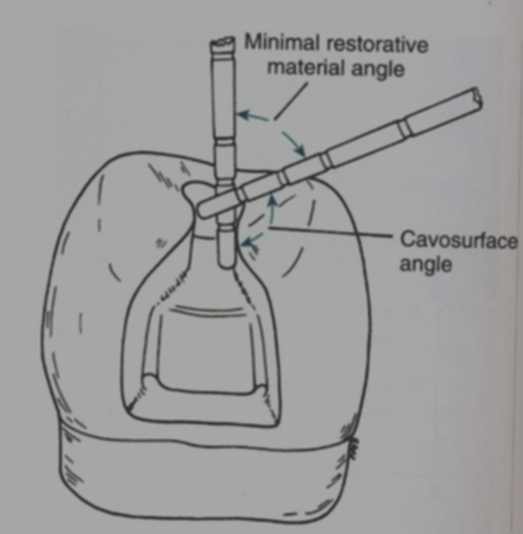

Slide 23
Cavosurface Angle
The actual junction is called as Cavosurface Margin.
Cavosurface Angle varies with : 1] location of tooth. 2] type of restorative material. 3] position of enamel rods.

Slide 24
Junctions
Dentinoenamel Junction : it is the junction of enamel & dentin.
Cementoenamel Junction : it is the junction of enamel & cementum.It is also called as Cervical Line .

Slide 25
Enamel Margin Strength
Strongest enamel margin : consists of : a] formed by full length enamel rods whose inner ends are on sound dentin. b] enamel rods are buttressed on preparation side by progressively shorter rods.

Slide 26
Classification given by the G.V. BLACK
CLASS I – Caries beginning in structural defects like pits and fissures that occur on occlusal surfaces of premolars and molars, the occlusal two thirds of the buccal and lingual surfaces of the molars, the lingual surfaces of maxillary incisors.
CLASS II – Caries on the proximal surfaces of molars and premolars.
CLASS III – Caries on proximal surfaces of incisors and canines, but not involving incisal angle.

Slide 27
CLASS IV – Caries on proximal surfaces of incisors and canines, but also involving the incisal angle.
CLASS V – Caries on the gingival third of facial and lingual surfaces of teeth.
CLASS VI – Caries on incisal edges and cusp tips of all the teeth

Slide 28
TAKE HOME MESSEGE/ FOR THE TOPIC COVERED (SUMMARY)
A cavity preparation is determined by many factors and each time a cavity is to be restored each of these factors must be assessed.
If the principles of cavity preparation are adhered to, the success of restoration increases
The factors that should be considered before initiating a cavity preparation are as follows :
Extent of carries
Occlusion
Pulpal involvement
Esthetics
Patients age
Operational skills

Slide 29
Question & Answer Session
What is infected dentin
What is affected dentin
Gv black classification

Slide 30
REFERENCES NAME OF THE BOOK WITH EDITION AND PAGE NUMBERS ARTICLE ARE TO BE MENTIONED IF NEEDED
ART AND SCIENCE OF OPERATIVE DENTISTRY
CLINICAL OPERATIVE DENTISTRY
TEXTBOOK OF PRECLINICAL CONSERVATRIVE DENTISTRY
PRINCIPLES AND PRACTICE OF OPERATIVE DENTISTRY

Slide 31
THANK YOU

